Slide 1

Power Flow and Harmonic Solution Modes
Roger C. Dugan
Sr. Technical Executive, EPRI
Jacobs Hall, UCSD
Dec 14-15, 2010

Slide 2
Solving the Power Flow
Once the circuit model is connected properly the next step is to solve the base power flow
Power Conversion elements (PC elements) are often nonlinear
Load are converted to a Norton equivalent based on nominal 100% rated voltage.
  Current source is “compensation current”
A fixed point solution algorithm is employed for most solutions
This method allows for flexible load models and is fairly robust for most distribution systems

Slide 3
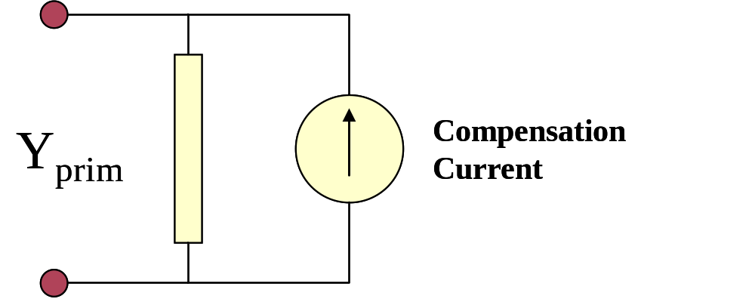
Load (a PC Element)
General Concept
Added into Injection Current Vector
Goes into System Y Matrix
(One-Line Diagram)
Most Power Conversion (PC) Elements are Modeled Like This

Slide 4
Load - 3-phase Y connected
Phase 1
1
2
Phase 2
3
4 Conductors/Terminal
Phase 3
4

Slide 5
Load - 3-phase Delta connected
Phase 1
2
1
Phase 2
3
3 Conductors/Terminal
Phase 3

Slide 6
Load Models (Present version)
1:Standard constant P+jQ load. (Default)
2:Constant impedance load.
3:Const P, Quadratic Q (like a motor).
4:Nominal Linear P, Quadratic Q (feeder mix). Use this with CVRfactor.
5:Constant Current Magnitude
6:Const P, Fixed Q
7:Const P, Fixed Impedance Q

Slide 7
Standard P + jQ Load Model
When the voltage goes out of the normal range for a load the model reverts to a linear load model
  This generally guarantees convergence
    Even when a fault is applied
  To change break points to +/- 10%:
    Load.Load1.Vmaxpu=1.10
    Load.Load1.Vminpu=0.90
  Note: to solve some of the IEEE Radial Test feeders and match the published results, you have to set Vminpu to less than the lowest voltage published

Slide 8
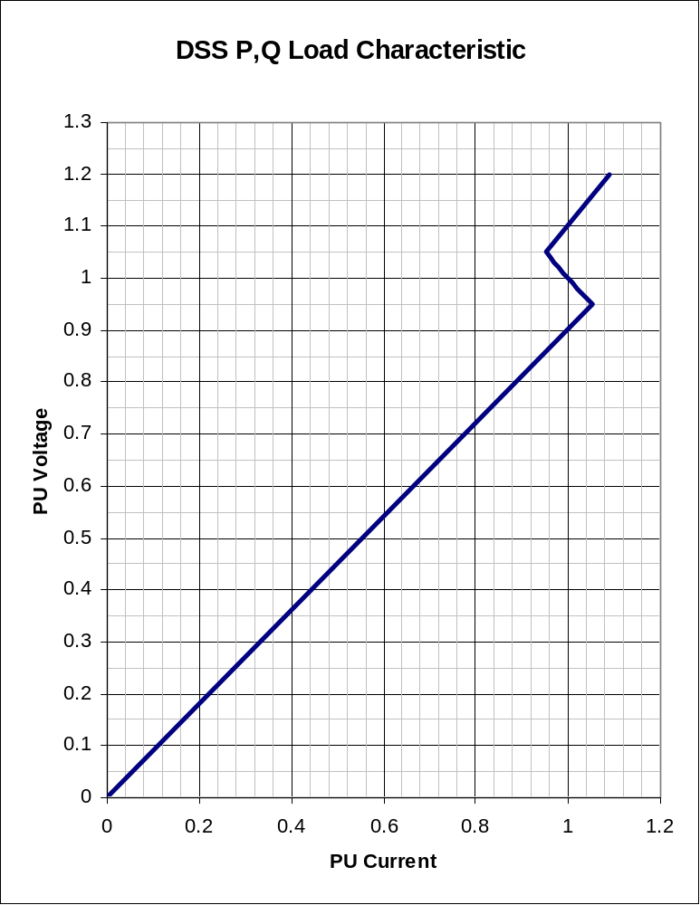
Standard P + jQ Load Model (Model=1)
Const Z
105%
(Defaults*)
95%
|I| = |S/V|
Const Z
* Change by setting Vminpu and Vmaxpu Properties

Slide 9
Putting it All Together
ALL Elements
Yprim 1
Yprim 2
Yprim 3
Yprim n
PC Elements
Comp. Currents
I1
I2
Y
Node
Voltages
I_{inj}
=
V
Im
Iteration Loop

Slide 10
Putting it All Together
Th-Th-That's All Folks !
ALL Elements
Yprim 1
Yprim 2
Yprim 3
Yprim n
PC Elements
Comp. Currents
I1
I2
Y
Node
Voltages
I_{inj}
=
V
Im
Iteration Loop

Slide 11
Solving the Power Flow
This solution method requires that the first guess at the voltages be close to the final solution
  Not a problem for daily or yearly simulations
  First solution is often most difficult
The solution initialization routine in OpenDSS accomplishes this in most cases
Method works well for arbitrary unbalances
For conditions that are sensitive, a Newton method is provided that is more robust, but slower.

Slide 12
Solution Speed
Distribution systems generally converge very well
  Many transmission systems, also
The OpenDSS program seems to be on par with the faster commercial programs
Solution method is designed to run annual simulations
Our philosophy:
    Err on the side of running more power flow simulations
      Don’t worry about the solution time until it proves to be a problem
      This reveals more information about the problem

Slide 13
Harmonic Solution

Slide 14
Solving for Harmonic Flows
The OpenDSS solution algorithm heritage
    McGraw-Edison Steady-State Analysis Program (MESSAP) 1977-78
    McGraw-Edison Harmonic Analysis Program (MEHAP) 1979-1982
    McGraw/Cooper V-Harm® program (1984)
    Electrotek Concepts SuperHarm® program (1990-92)
    Electrotek DSS (1997)
Harmonic solution has been an integral part of the program since its inception

Slide 15
Harmonic Solution
All Load elements have ‘Spectrum=default’
The default spectrum is a typical 3-phase ASD spectrum
  Redefine Spectrum.Default if you want something else
    Edit spectrum.default …
Harmonic solution requires a converged power flow solution to initialize all the harmonic sources
  Do Solve mode=direct if convergence is difficult to achieve
Typical script
  Solve ! Snapshot power flow
  Solve mode=harmonics ! Make sure you have Monitors

Slide 16
Harmonic Solution Mode
Basically the same method
  Solve the power flow
  Harmonic currents initialized to match the fundamental frequency solution
  “Solve Mode=Harmonics”
    Program solves at each frequency
    Non-iterative
    Harmonic currents assumed invariant
    Y matrix is rebuilt for each frequency

Slide 17
Putting it All Together - Harmonics
ALL Elements, each frequency
Yprim 1
Yprim 2
Yprim 3
Yprim n
PC Elements
Harmonic injection Currents
I1
I2
Y
Node
Voltages
(each Frequency)
I_{inj}
=
V
Im

Slide 18
References
OpenDSS Tech Notes: http://sourceforge.net/apps/mediawiki/electricdss/index.php?title=List_of_DSS_tech_notes
OpenDSS Forum:
http://sourceforge.net/projects/electricdss/forums/forum/861976
Frequently-Asked Questions:
http://www.rogerdugan.com/OpenDSS/sourceforgelinks.html
Main Documentation Area:
http://electricdss.svn.sourceforge.net/viewvc/electricdss/Doc/

Slide 19
Together…Shaping the Future of Electricity

